Slide 1

Intro-Machine Learning mod. 1 Clustering (1)
Fosca Giannotti
Revisited slides from Lecture Notes for Chapter 7 “Introduction to Data Mining”, 2nd Edition by Tan, Steinbach, Karpatne, Kumar

Slide 2
What is Cluster Analysis?
Finding groups of objects such that the objects in a group will be similar (or related) to one another and different from (or unrelated to) the objects in other groups
Inter-cluster distances are maximized
Intra-cluster distances are minimized

Slide 3
Preliminary concepts: Similarity and Dissimilarity
Similarity
Numerical measure of how alike two data objects are.
Is higher when objects are more alike.
Often falls in the range [0,1]
Dissimilarity
Numerical measure of how different are two data objects
Lower when objects are more alike
Minimum dissimilarity is often 0
Upper limit varies
Proximity refers to a similarity or dissimilarity

Slide 4
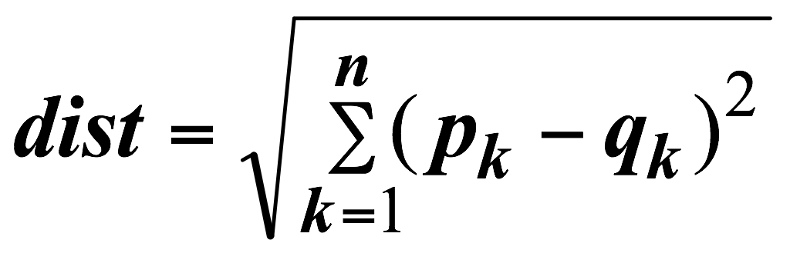
Preliminary concepts: Euclidean Distance
Euclidean Distance
Where n is the number of dimensions (attributes) and p_{k} and q_{k} are, respectively, the k^{th} attributes (components) or data objects p and q.
Standardization is necessary, if scales differ.

Slide 5
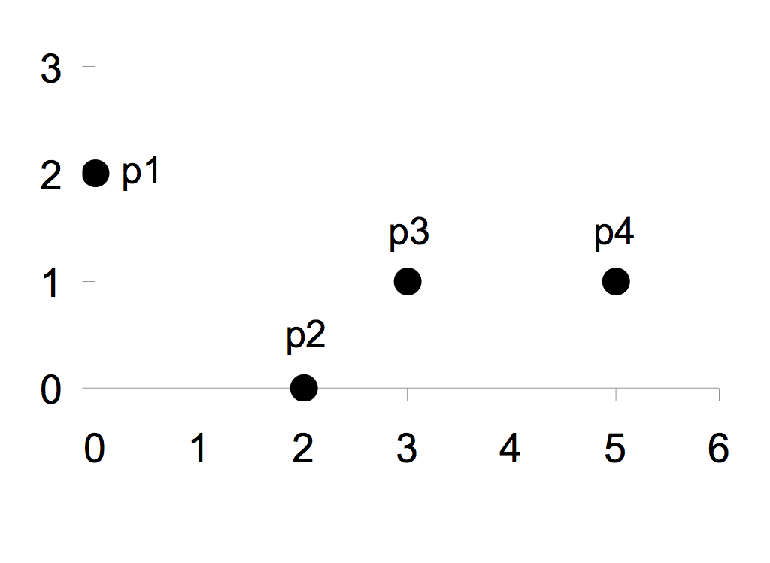
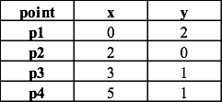
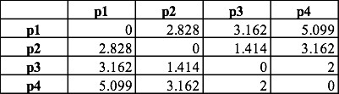
Euclidean Distance
Distance Matrix

Slide 6
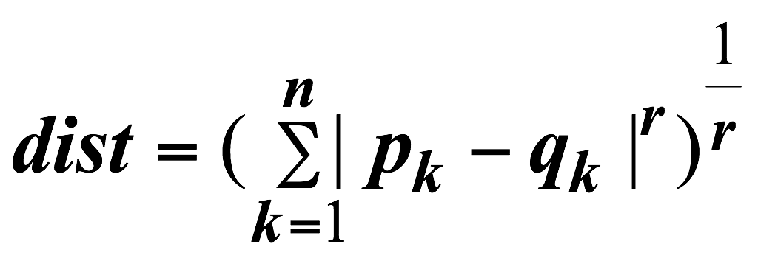
Minkowski Distance
Minkowski Distance is a generalization of Euclidean Distance
Where r is a parameter, n is the number of dimensions (attributes) and p_{k} and q_{k} are, respectively, the kth attributes (components) or data objects p and q.

Slide 7
Minkowski Distance: Examples
r = 1. City block (Manhattan, taxicab, L₁ norm) distance.
A common example of this is the Hamming distance, which is just the number of bits that are different between two binary vectors
r = 2. Euclidean distance
r → ∞. “supremum” (L_{max} norm, L∞ norm) distance.
This is the maximum difference between any component of the vectors
Do not confuse r with n, i.e., all these distances are defined for all numbers of dimensions.

Slide 8
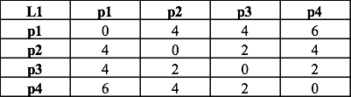
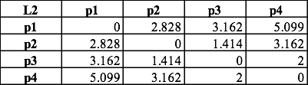
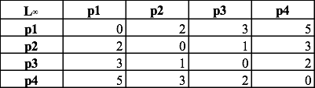
Minkowski Distance
Distance Matrix

Slide 9
Similarity Between Binary Vectors
Common situation is that objects, p and q, have only binary attributes
Compute similarities using the following quantities
M₀₁ = the number of attributes where p was 0 and q was 1
M₁₀ = the number of attributes where p was 1 and q was 0
M₀₀ = the number of attributes where p was 0 and q was 0
M₁₁ = the number of attributes where p was 1 and q was 1
Simple Matching and Jaccard Coefficients
SMC = number of matches / number of attributes
= (M11 + M00) / (M01 + M10 + M11 + M00)
Jaccard = number of 11 matches / number of not-both-zero attributes values
_{= (M11) / (M01 + M10 + M11)}

Slide 10
SMC versus Jaccard: Example
p = 1 0 0 0 0 0 0 0 0 0
q = 0 0 0 0 0 0 1 0 0 1
M₀₁ = 2 (the number of attributes where p was 0 and q was 1)
M₁₀ = 1 (the number of attributes where p was 1 and q was 0)
M₀₀ = 7 (the number of attributes where p was 0 and q was 0)
M₁₁ = 0 (the number of attributes where p was 1 and q was 1)
SMC = (M₁₁ + M₀₀)/(M₀₁ + M₁₀ + M₁₁ + M₀₀) = (0+7) / (2+1+0+7) = 0.7
J = (M₁₁) / (M₀₁ + M₁₀ + M₁₁) = 0 / (2 + 1 + 0) = 0

Slide 11
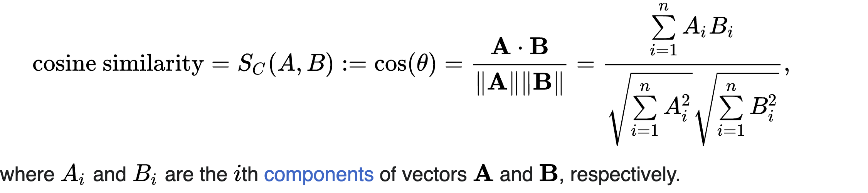
Cosine Similarity
If d₁ and d₂ are two document vectors, then
cos( d₁, d₂ ) = (d₁ • d₂) / ||d₁|| ||d₂|| ,
where • indicates vector dot product and || d || is the length of vector d.
Example:
d₁ = 3 2 0 5 0 0 0 2 0 0
d₂ = 1 0 0 0 0 0 0 1 0 2
d₁ • d₂= 3*1 + 2*0 + 0*0 + 5*0 + 0*0 + 0*0 + 0*0 + 2*1 + 0*0 + 0*2 = 5
||d₁|| = (3*3+2*2+0*0+5*5+0*0+0*0+0*0+2*2+0*0+0*0)^{0.5} = (42) ^{0.5} = 6.481
||d₂|| = (1*1+0*0+0*0+0*0+0*0+0*0+0*0+1*1+0*0+2*2) ^{0.5} = (6) ^{0.5} = 2.245
cos( d₁, d₂ ) = .3150

Slide 12
What is Cluster Analysis?
Finding groups of objects such that the objects in a group will be similar (or related) to one another and different from (or unrelated to) the objects in other groups
Inter-cluster distances are maximized
Intra-cluster distances are minimized

Slide 13
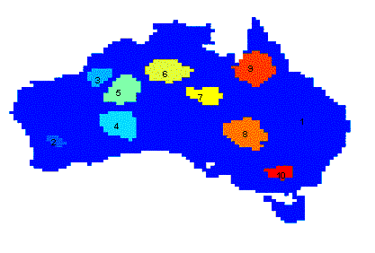
Applications of Cluster Analysis
Understanding
Group related documents for browsing, group genes and proteins that have similar functionality, or group stocks with similar price fluctuations
Summarization
Reduce the size of large data sets
Clustering precipitation in Australia

Slide 14
What is not Cluster Analysis?
Simple segmentation
Dividing students into different registration groups alphabetically, by last name
Results of a query
Groupings are a result of an external specification
Clustering is a grouping of objects based on the data
Supervised classification
Have class label information
Association Analysis
Local vs. global connections

Slide 15
Notion of a Cluster can be Ambiguous
How many clusters?
Six Clusters
Two Clusters
Four Clusters

Slide 16
Types of Clusterings
A clustering is a set of clusters
Important distinction between hierarchical and partitional sets of clusters
Partitional Clustering
A division of data objects into non-overlapping subsets (clusters) such that each data object is in exactly one subset
Hierarchical clustering
A set of nested clusters organized as a hierarchical tree

Slide 17
Partitional Clustering
Original Points
A Partitional Clustering

Slide 18
Hierarchical Clustering
Traditional Hierarchical Clustering
Traditional Dendrogram

Slide 19
Other Distinctions Between Sets of Clusters
Exclusive versus non-exclusive
In non-exclusive clusterings, points may belong to multiple clusters.
Can represent multiple classes or ‘border’ points
Fuzzy versus non-fuzzy
In fuzzy clustering, a point belongs to every cluster with some weight between 0 and 1
Weights must sum to 1
Probabilistic clustering has similar characteristics
Partial versus complete
In some cases, we only want to cluster some of the data
Heterogeneous versus homogeneous
Clusters of widely different sizes, shapes, and densities

Slide 20
Types of Clusters
Well-separated clusters
Center-based clusters
Contiguous clusters
Density-based clusters

Slide 21
Types of Clusters: Well-Separated
Well-Separated Clusters:
A cluster is a set of points such that any point in a cluster is closer (or more similar) to every other point in the cluster than to any point not in the cluster.
3 well-separated clusters

Slide 22
Types of Clusters: Center-Based
Center-based
A cluster is a set of objects such that an object in a cluster is closer (more similar) to the “center” of a cluster, than to the center of any other cluster
The center of a cluster is often a centroid, the average of all the points in the cluster, or a medoid, the most “representative” point of a cluster
4 center-based clusters

Slide 23
Types of Clusters: Contiguity-Based
Contiguous Cluster (Nearest neighbor or Transitive)
Each point is closer to at least one point in its cluster than to any point in another cluster.
Graph based clustering
This approach can have trouble when noise is present since a small bridge of points can merge two distinct clusters
8 contiguous clusters

Slide 24
Types of Clusters: Density-Based
Density-based
A cluster is a dense region of points, which is separated by low-density regions, from other regions of high density.
Used when the clusters are irregular or intertwined, and when noise and outliers are present.
6 density-based clusters

Slide 25
Types of Clusters: Objective Function
Clusters Defined by an Objective Function
Finds clusters that minimize or maximize an objective function.
Enumerate all possible ways of dividing the points into clusters and evaluate the `goodness' of each potential set of clusters by using the given objective function. (NP Hard)
Can have global or local objectives.
Hierarchical clustering algorithms typically have local objectives
Partitional algorithms typically have global objectives

Slide 26
Characteristics of the Input Data Are Important
Type of proximity or density measure
Central to clustering
Depends on data and application
Data characteristics that affect proximity and/or density are
Dimensionality
Sparseness
Attribute type
Special relationships in the data
For example, autocorrelation
Distribution of the data
Noise and Outliers
Often interfere with the operation of the clustering algorithm

Slide 27
Clustering Algorithms
K-means and its variants
Hierarchical clustering
Density-based clustering

Slide 28
K-Means

Slide 29
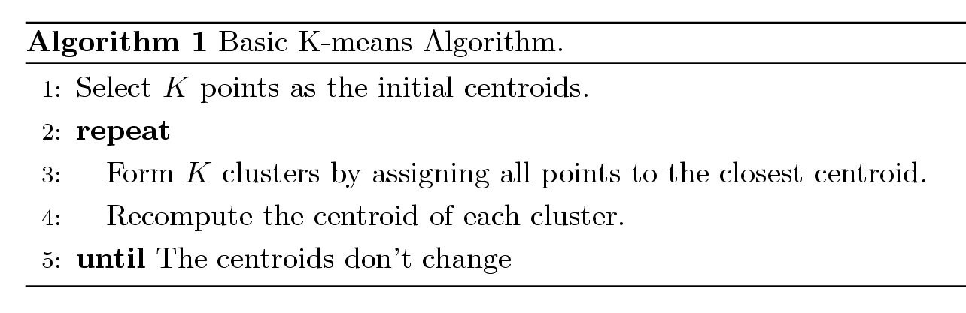
K-means Clustering
Partitional clustering approach
Number of clusters, K, must be specified
Each cluster is associated with a centroid (center point)
Each point is assigned to the cluster with the closest centroid
The basic algorithm is very simple

Slide 30
Example of K-means Clustering

Slide 31
Example of K-means Clustering

Slide 32
K-means Clustering – Details
Initial centroids are often chosen randomly.
Clusters produced vary from one run to another.
The centroid is (typically) the mean of the points in the cluster.
‘Closeness’ is measured by Euclidean distance, cosine similarity, correlation, etc.
K-means will converge for common similarity measures mentioned above.
Most of the convergence happens in the first few iterations.
Often the stopping condition is changed to ‘Until relatively few points change clusters’
Complexity is O( n * K * I * d )
n = number of points, K = number of clusters, I = number of iterations, d = number of attributes

Slide 33
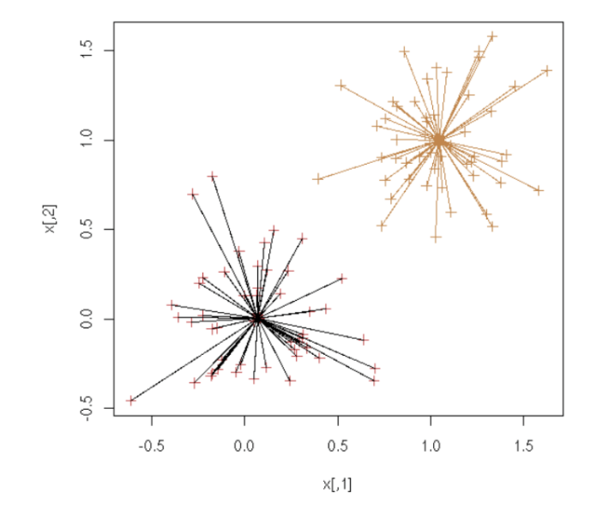
Evaluating K-means Clusters
Most common measure and objective function is Sum of Squared Error (SSE)
For each point, the error is the distance to the nearest centroid
To get SSE, we square these errors and sum them.
x is a data point in cluster C_{i} and m_{i} is the representative point for cluster Ci
can show that mi corresponds to the center (mean) of the cluster
Given two sets of clusters, we prefer the one with the smallest error
One easy way to reduce SSE is to increase K, the number of clusters
A good clustering with smaller K can have a lower SSE than a poor clustering with higher K

Slide 34
Two different K-means Clusterings
Original Points
Optimal Clustering
Sub-optimal Clustering

Slide 35
Importance of Choosing Initial Centroids

Slide 36
Importance of Choosing Initial Centroids

Slide 37
Importance of Choosing Initial Centroids …

Slide 38
Importance of Choosing Initial Centroids …

Slide 39
10 Clusters Example
Starting with two initial centroids in one cluster of each pair of clusters

Slide 40
10 Clusters Example
Starting with two initial centroids in one cluster of each pair of clusters

Slide 41
10 Clusters Example
Starting with some pairs of clusters having three initial centroids, while other have only one.

Slide 42
10 Clusters Example
Starting with some pairs of clusters having three initial centroids, while other have only one.

Slide 43
Solutions to Initial Centroids Problem
Multiple runs
Helps, but probability is not on your side
Sample and use hierarchical clustering to determine initial centroids
Select more than k initial centroids and then select among these initial centroids
Select most widely separated
Postprocessing
Generate a larger number of clusters and then perform a hierarchical clustering
Bisecting K-means
Not as susceptible to initialization issues

Slide 44
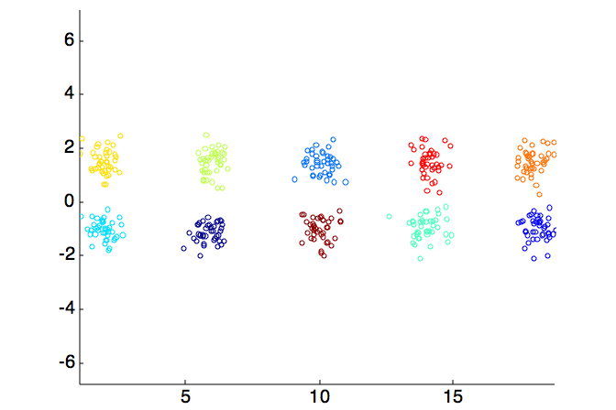
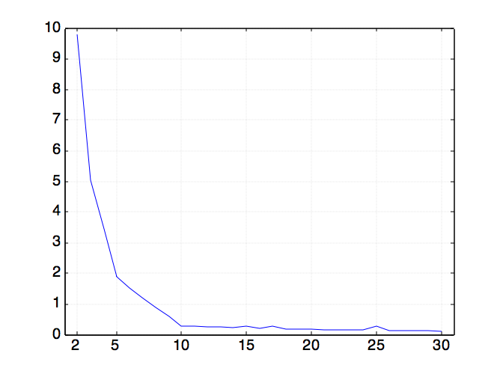
How many clusters? Choosing K
Clusters in more complicated figures aren’t well separated
Internal Index: Used to measure the goodness of a clustering structure without respect to external information
SSE
SSE is good for comparing two clusterings or two clusters (average SSE).
Can also be used to estimate the number of clusters
Notes:
Per ogni K molti esperimenti (con centroidi iniziai diversi) si plotta la SSE migliore. Aumentando il K la SSE migliora ma ad un certo punto rallenta tantissimo. Il K migliore è quello sul gomito della curva

Slide 45
Limitations of K-means
K-means has problems when clusters are of differing
Sizes
Densities
Non-globular shapes
K-means has problems when the data contains outliers.

Slide 46
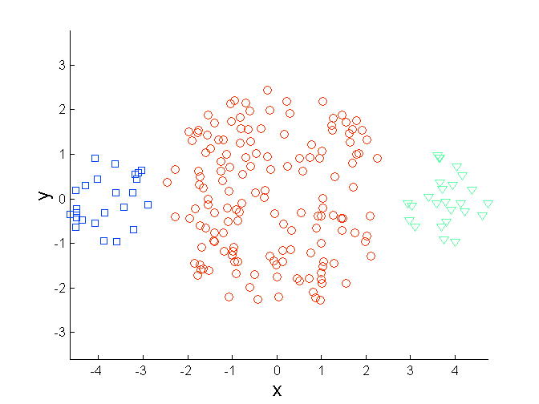
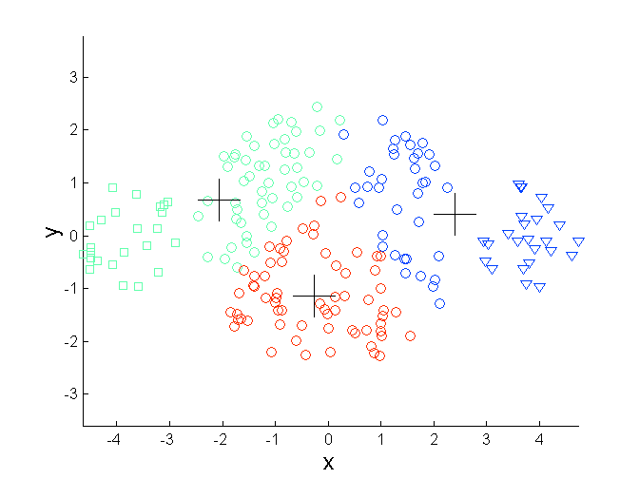
Limitations of K-means: Differing Sizes
Original Points
K-means (3 Clusters)

Slide 47
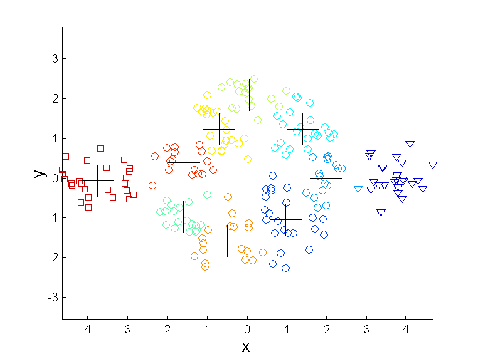
Overcoming K-means Limitations
Original Points K-means Clusters
One solution is to use many clusters.
Find parts of clusters, but need to put together.

Slide 48
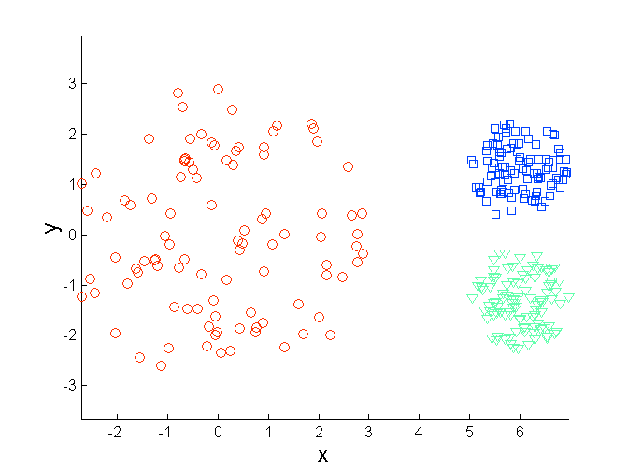
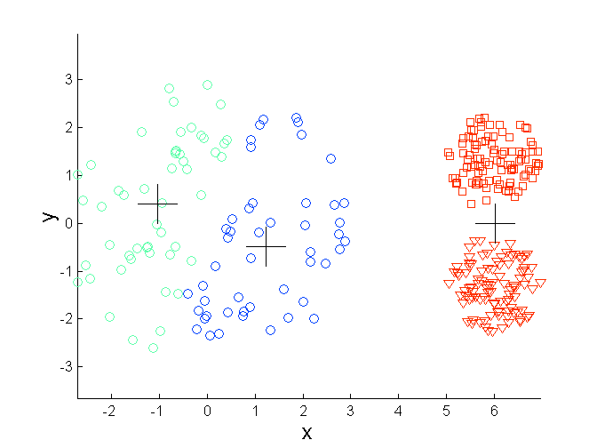
Limitations of K-means: Differing Density
Original Points
K-means (3 Clusters)

Slide 49
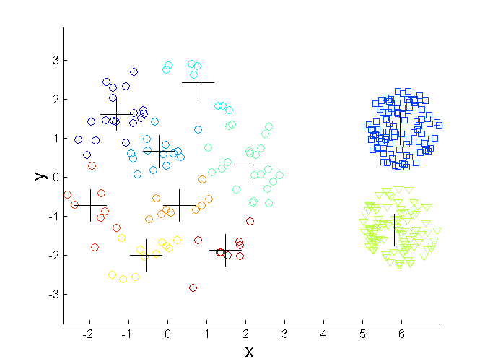
Overcoming K-means Limitations
Original Points K-means Clusters

Slide 50
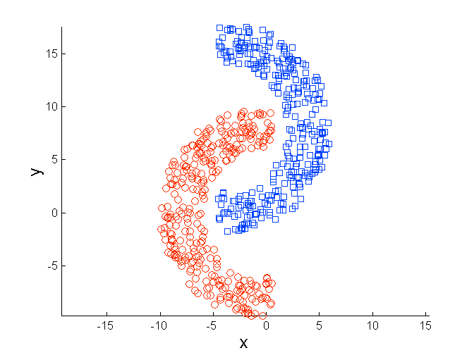
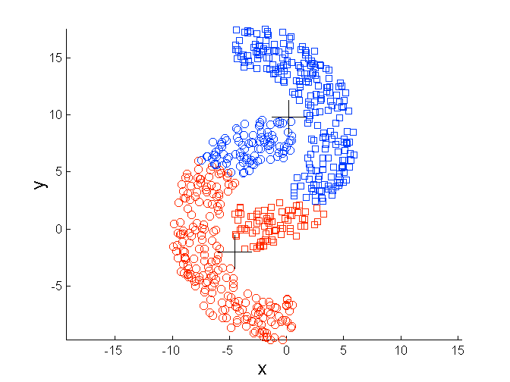
Limitations of K-means: Non-globular Shapes
Original Points
K-means (2 Clusters)

Slide 51
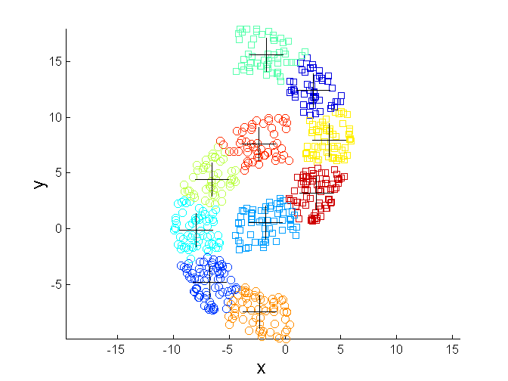
Overcoming K-means Limitations
Original Points K-means Clusters

Slide 52
Pre-processing and Post-processing
Pre-processing
Normalize the data
Eliminate outliers
Post-processing
Eliminate small clusters that may represent outliers
Split ‘loose’ clusters, i.e., clusters with relatively high SSE
Merge clusters that are ‘close’ and that have relatively low SSE
Can use these steps during the clustering process
ISODATA

Slide 53
Limitations of K-means
K-means has problems when clusters are of differing
Sizes
Densities
Non-globular shapes
K-means has problems when the data contains outliers.

Slide 54
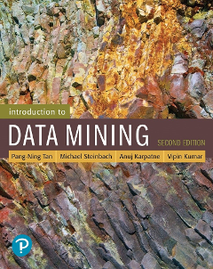
References
Clustering. Chapter 7. Introduction to Data Mining.

Slide 55
1
Competitive Intelligence

Slide 56
competitive intelligence:
Source: DM@CINECA
http://open.cineca.it/datamining/dmCineca/

Slide 57
A small example
Domain: technology watch - a.k.a. competitive intelligence
Which are the emergent technologies?
Which competitors are investing on them?
In which area are my competitors active?
Which area will my competitor drop in the near future?
Source of data:
public (on-line) databases

Slide 58
The Derwent database
Contains all patents filed worldwide in last 10 years
Searching this database by keywords may yield thousands of documents
Derwent document are semi-structured: many long text fields
Goal: analyze Derwent document to build a model of competitors’ strategy

Slide 59
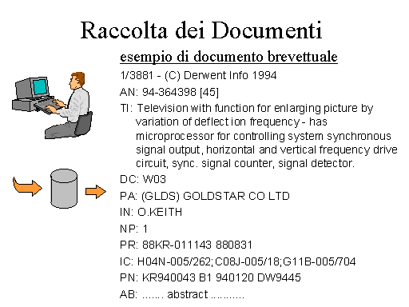

Slide 60
Example dataset
Patents in the area: cerotto medicale
105 companies from 12 countries
94 classification codes
52 Derwent codes

Slide 61
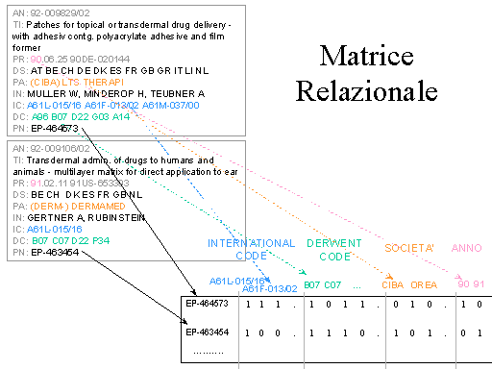
Data Preparation

Slide 62
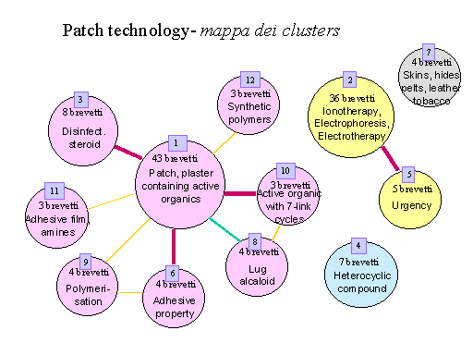
Clustering output

Slide 63
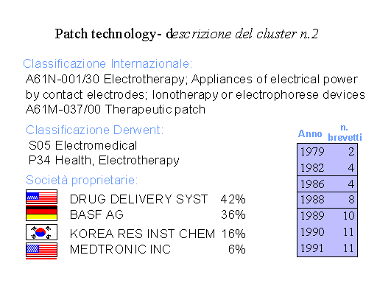
Zoom on cluster 2

Slide 64
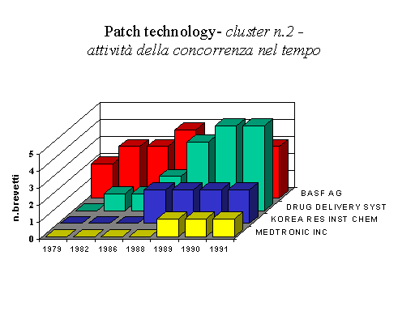
Zoom on cluster 2 - profiling competitors

Slide 65
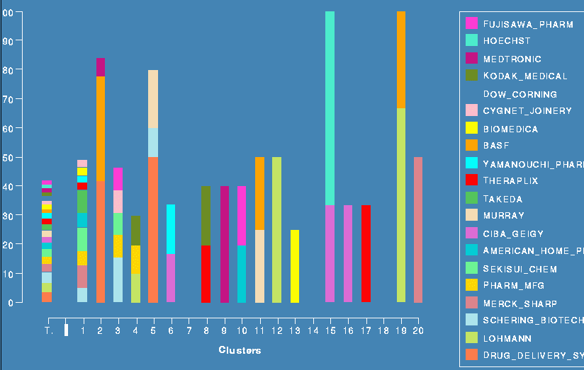
Activity of competitors in the clusters

Slide 66
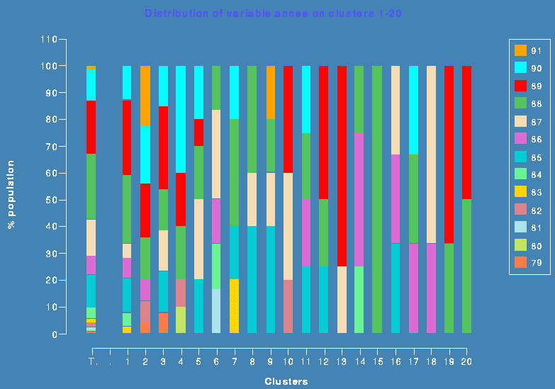
Temporal analysis of clusters

